Slide 1
Group 2
Courtney, Lewis, Tom, and Heather

Slide 2
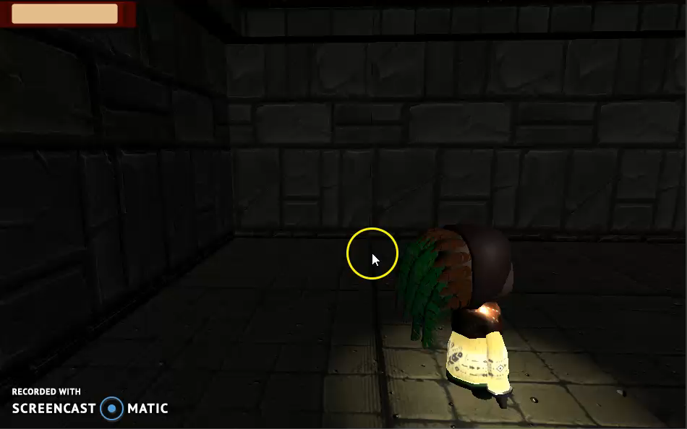
Game Footage

Slide 3
ACHIEVING FLOW
Concrete goals with manageable rules
Goals that fit player capabilities.
Clear and timely feedback.
Eliminate distractions
Collectables

Slide 4
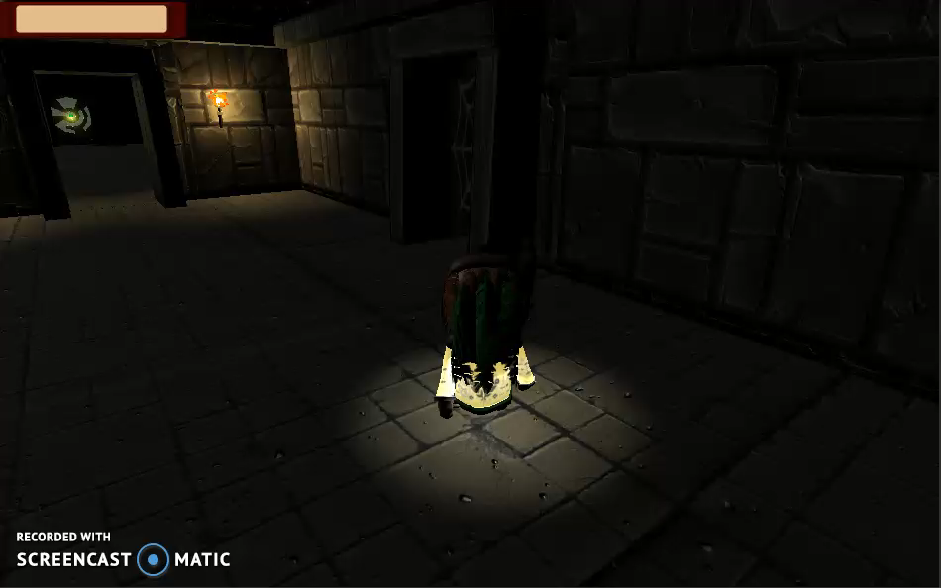
Mechanics
Managing the Light resource
Light Puzzle

Slide 5
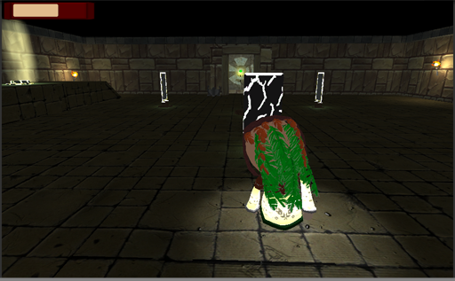
Goals
Colour affordances
Flashing lights/movement
Level design

Slide 6
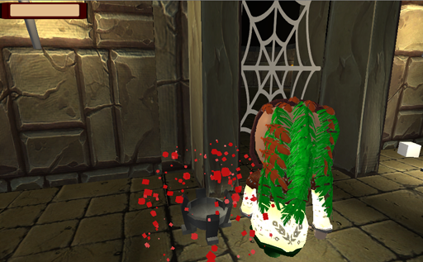
Feedback
Sounds
Visuals
Aesthetics

Slide 7
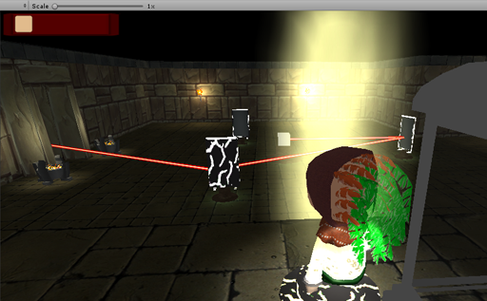
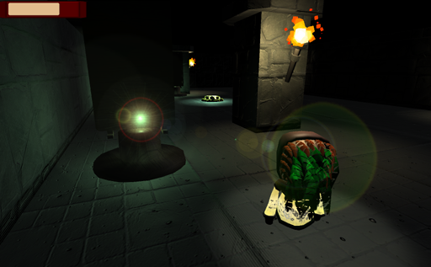
UI
Light resource
Objective
Pop up prompts

Slide 8
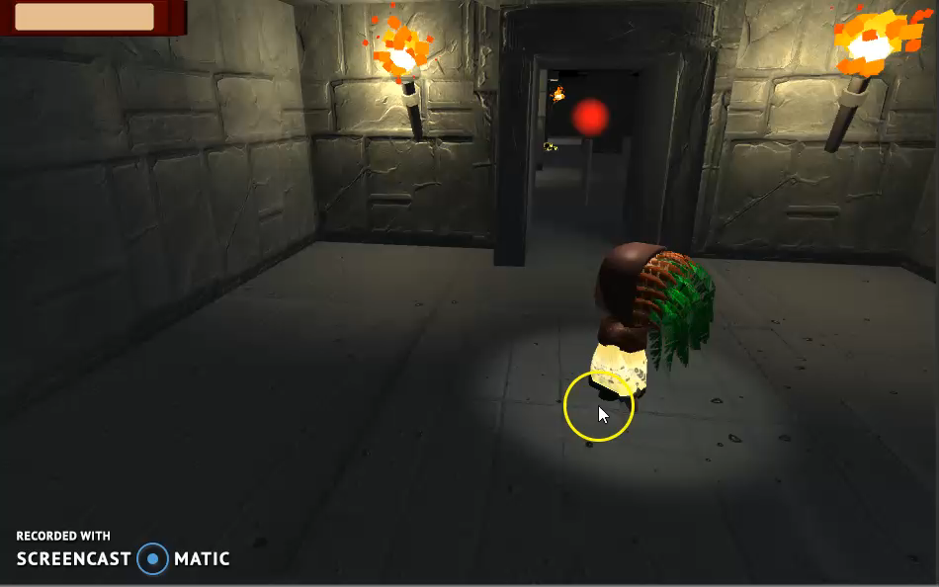
Level Design
Needs to make better use of sightlines to direct players
Very linear path
Needs props to fill space

Slide 9
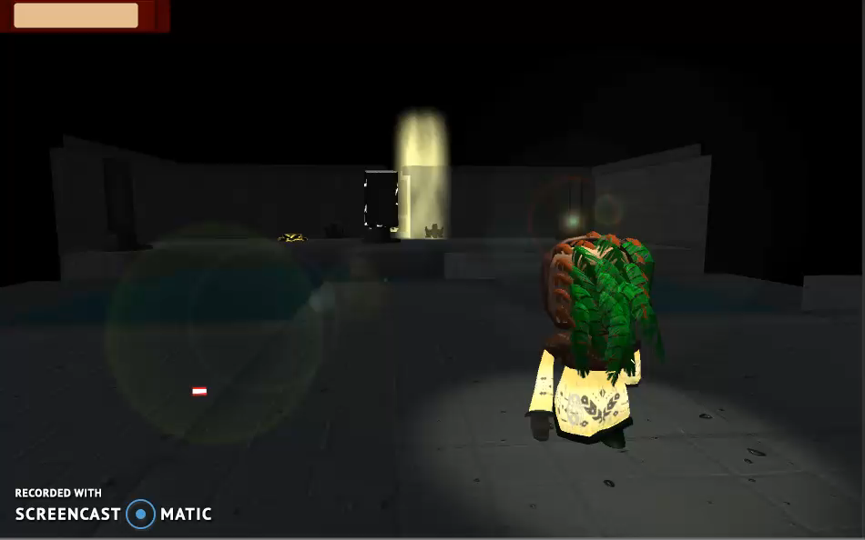
Level Design
-Medium/Small spaces
-Puzzle elements must all fit on screen together
More verticality and branching paths

Slide 10
Next Steps
Playtest.
Fix everything revealed by playtesting.
Polish.
Menu/End screen.
HB

Slide 11
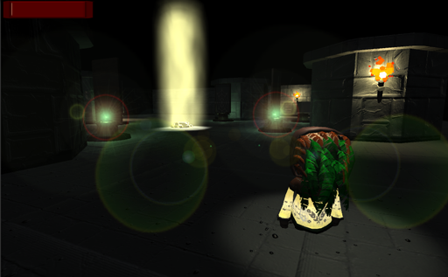
Any questions?

